Slide 1

Math and Science Academy
Brand Standards
Version .21, Dec 2nd, 2015

Slide 2
Table Of Contents
Brand Basics
  Who We Are
  How To Represent Us
Color Palette’s
Typography
Logo’s and Usage Requirements
Resources For Further Guidance

Slide 3
What Is The MSA Brand?
Our brand is what students, parents, academics, alumni, public servants, corporations, countries, and outside observers all think, feel, and respond to when they hear the words “Math and Science Academy” or “MSA”

Slide 4
How To Represent Us
Proud
Hardworking
“Geeky” or “Nerdy”, but not un-hip
Successful
Humble, Serving

Slide 5
Color Palette
Primary Color: Maroon
  PMS: SolidCoat1945C
  HEX: #ad0143
  R173, G1, B67
Secondary Color (Accent): Silver
  PMS: SolidCoat 877c
  HEX: #8a8d8e
  R138, G141, B142
Additional Color: Black

Slide 6
Typography
Gnolane or Arial for headers containing the school name
Official MSA Documents and letters should be formatted in Arial or Times New Roman, or a similar font.

Slide 7



Logos
MSA Has 1 Corporate Logo, with 3 acceptable deviations:
  Full Color On Light Background
  Black On Light Background
  White On Dark Background
  No Other Color Variations Should be used!
MSA Logo should contain the ® as
it is a registered trademark (10/1/2016)

Slide 8
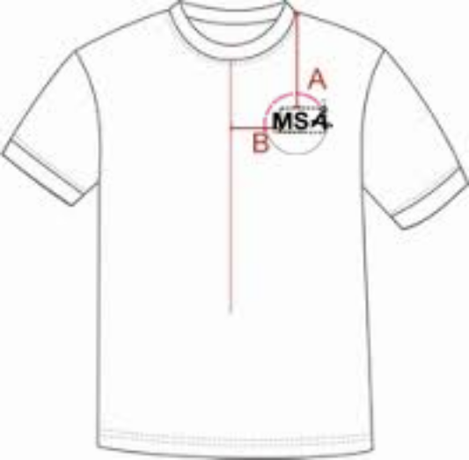
Logo Usage
This Logo should be used for all business
dealings with the school (letter head,
advertisements, etc.)
It should be the only logo used with MSA
branded apparel.
Logo should be positioned in upper right corner
of MSA apparel, similar to the image on the right.
Avoid anything “interfering” with the logo such
as added flourish.
Questions about whether or not a usage of the logo is appropriate should be submitted to the Director for approval prior to usage.

Slide 9
Mascots
MSA has 1 official mascots that can be used by teams: The Dragon
This Mascot must be used with all MSHSL based teams.
Non-MSHSL Teams May choose to use their own mascot with approval of the school.
The Fighting Calculators is reserved for the MSA Robotics Team, and should not be used for any other MSA Team without consent of the Robotics Team.

Slide 10
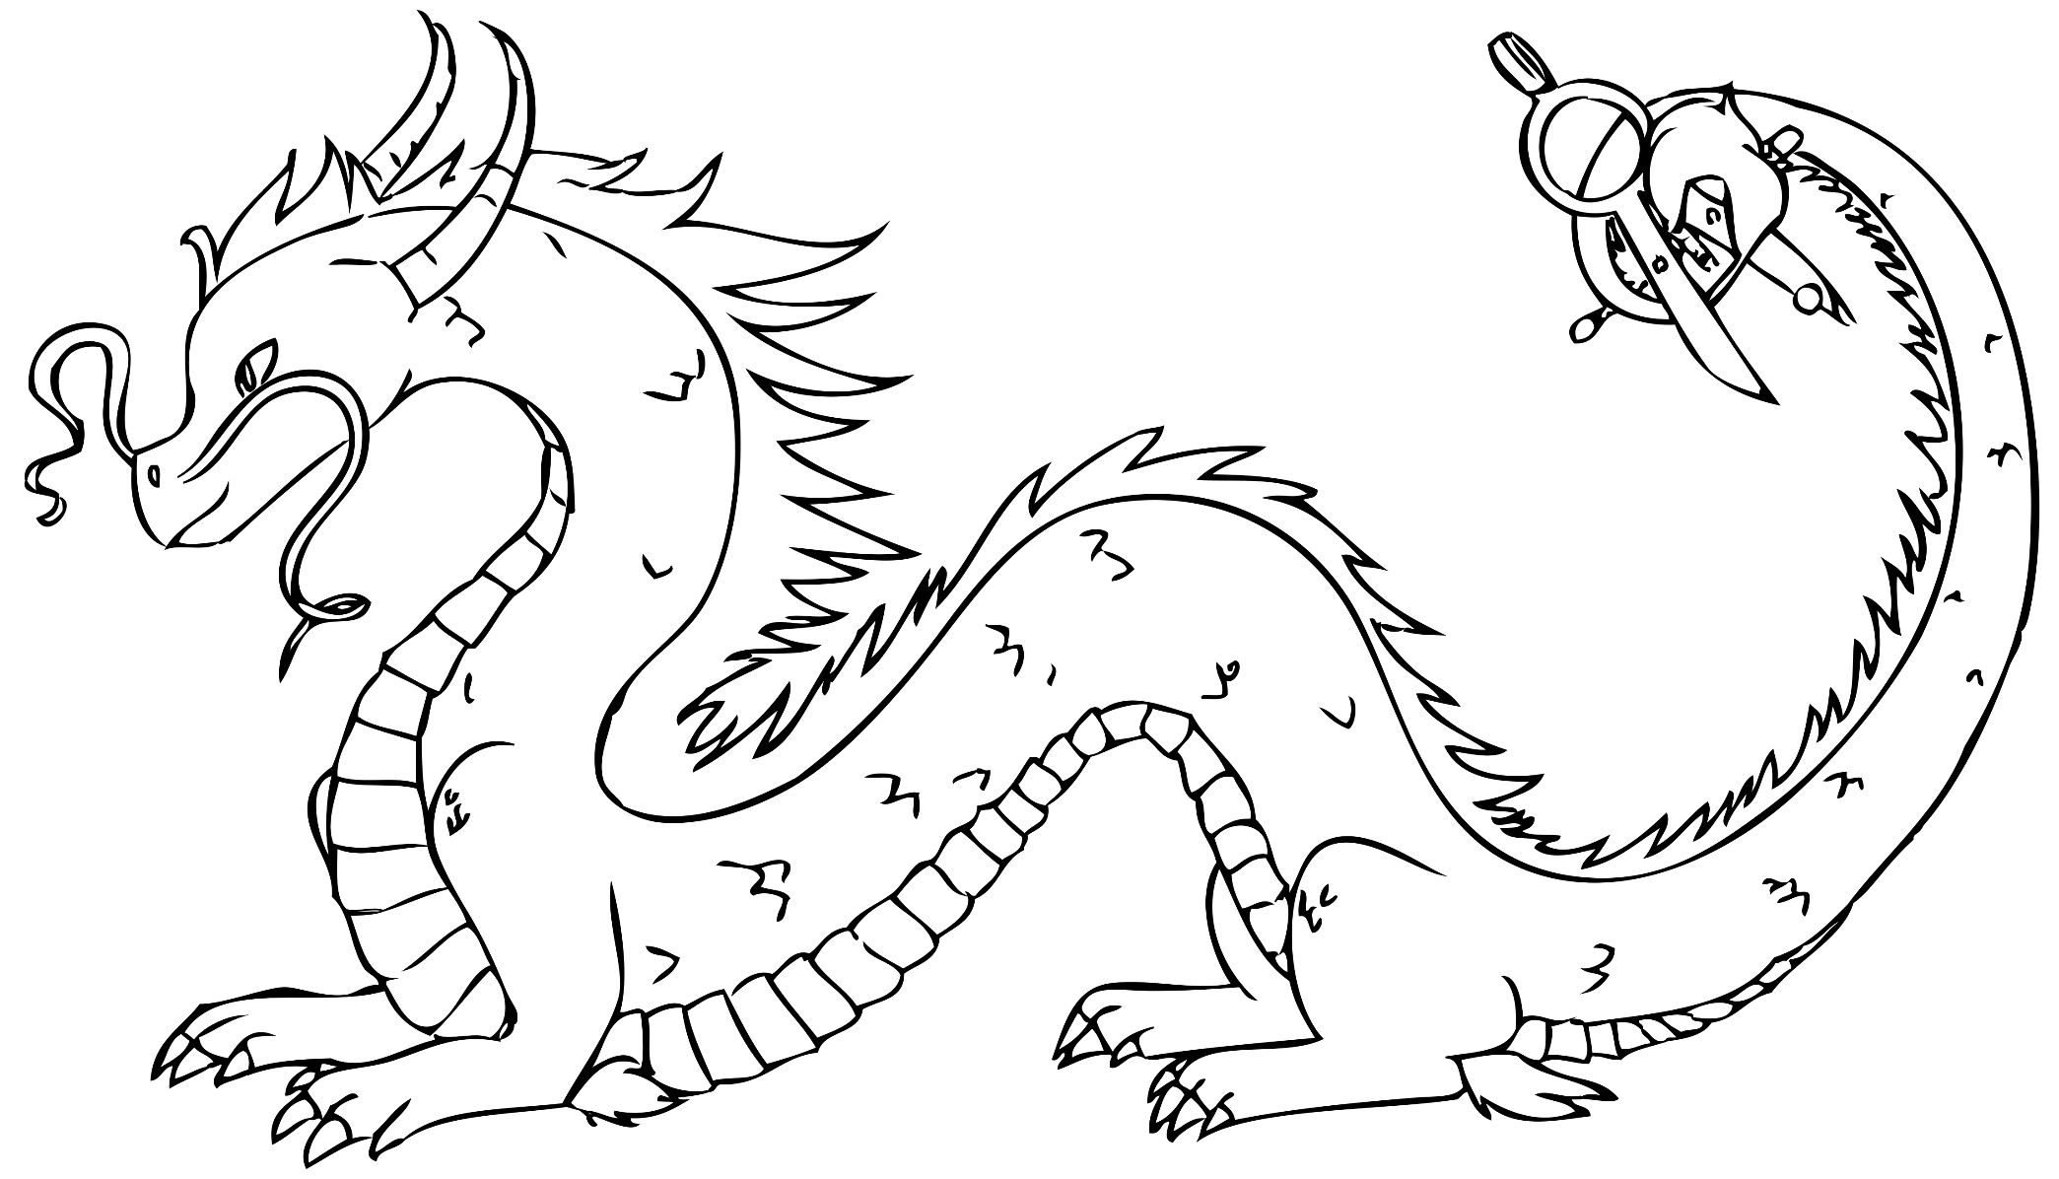
Mascots (The Dragon)

Slide 11

Mascots (The Dragon)
The Dragon may be cropped, but not altered in any other way. The board would rather the full
dragon be used whenever possible.

Slide 12
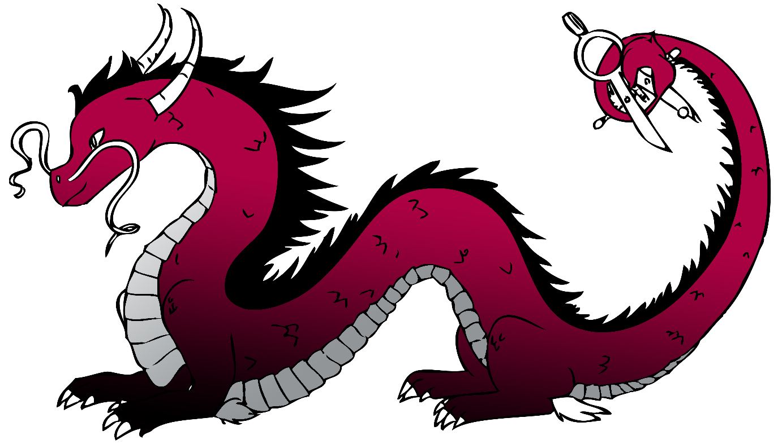
Mascots (The Dragon)
A Color Version Also Exists Should It Be Needed. Our Dragon always uses the MSA Colors (Maroon, Silver, Black)

Slide 13
Version History
0.21 – Added in ® details.
0.20 – Initial Approved Version

